Slide 1



Basic & Advance Excel
&
A short Briefing on Banking Analytics & Credit vs Debit

Slide 2
Below Activity Steps for DA Creating Visual & Dashboard for :-
To Collection of Database with different sources.
2. To ETL /EDA for data cleaning i.e finding outliers, unexpected data to change in required format(date time, text , integer)
3. To Processing to create Visualization, Dashboard and then finding insights.
Slide no 4 & 5 is in Excel Dashboard Presentation:-

Slide 3
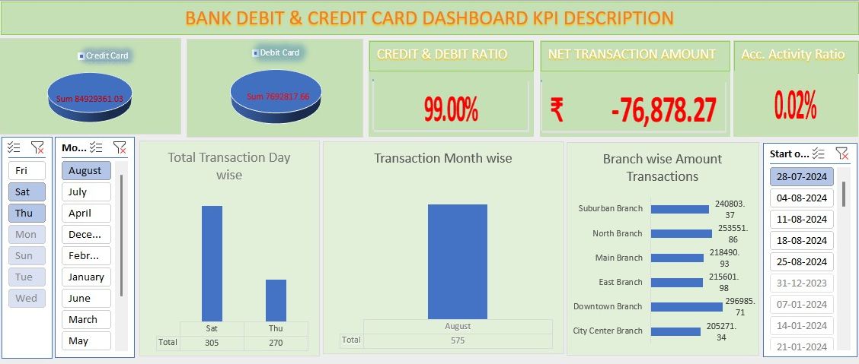
Below Credit & Debit Cards Visual Dashboard for :-

Slide 4
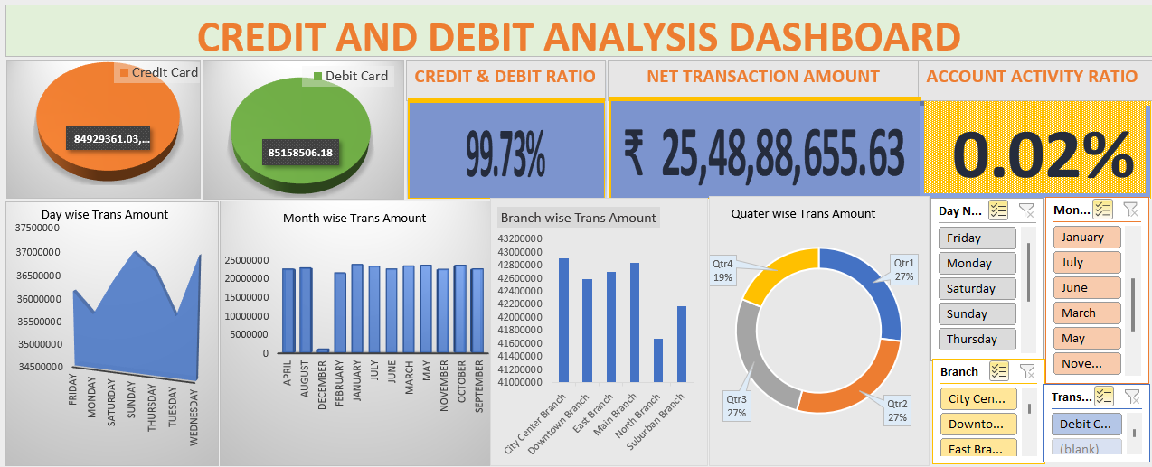

Slide 5
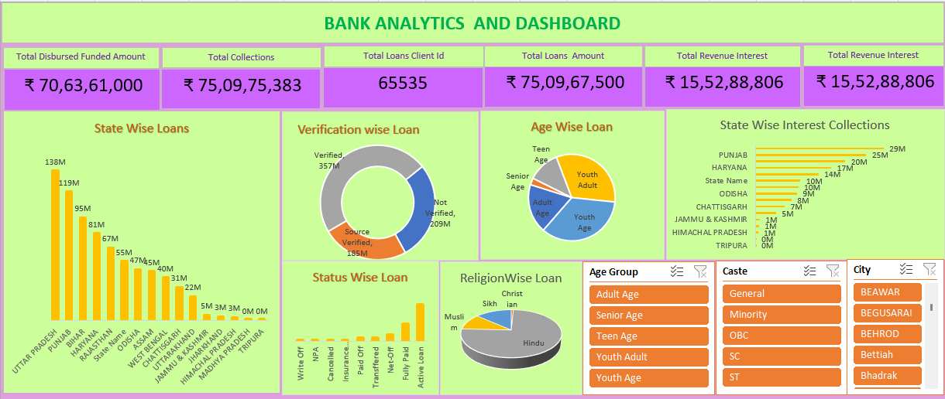
Below BANKING DATA ANALYSIS Visual Dashboard for :-

Slide 6
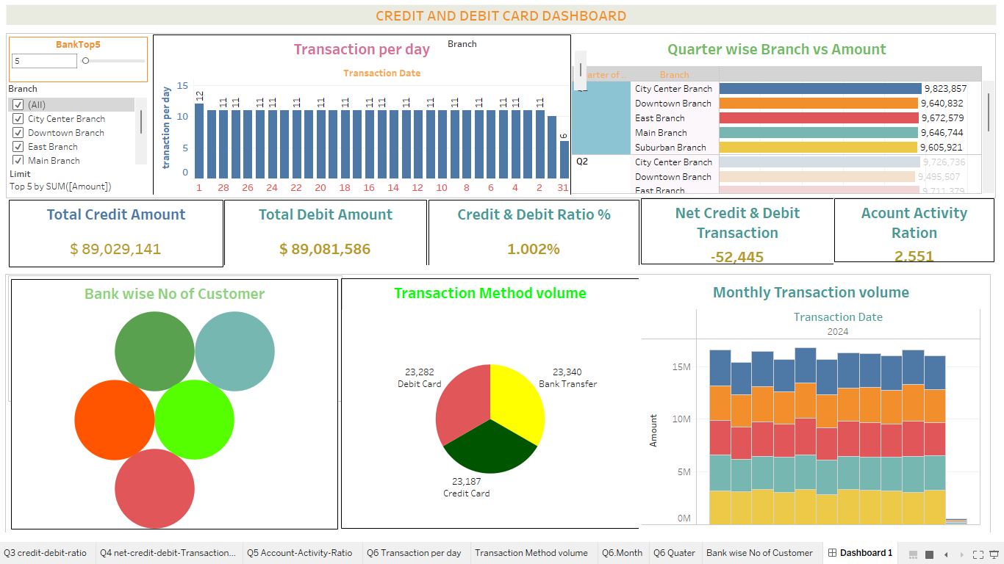
Tableau(Credit &Debit) Dashboard Presentation:-

Slide 7
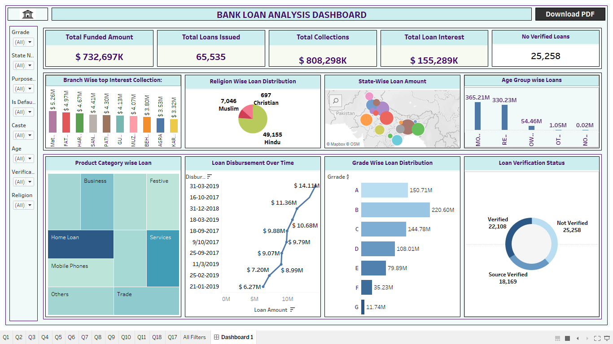

Slide 8
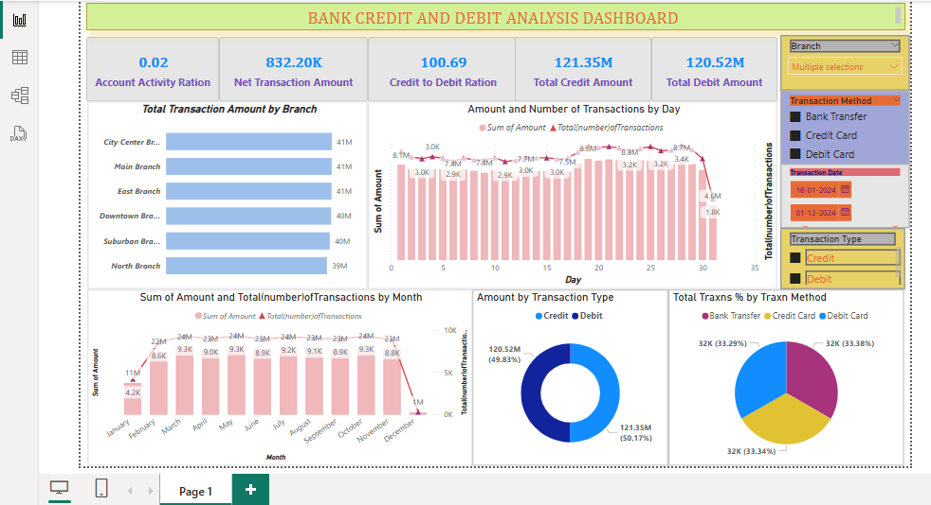
Power BI(Credit &Debit) Dashboard Presentation:-

Slide 9
Bank Analytics & Dashboard Analytics for Stake-Holders
Bank Debit and Credit Dashboard KPI Description
1-Total Credit Amount:
Formula: Sum of the Amount column where Transaction Type = "Credit".
Insight: Measures the total amount of deposits or credits, which can be compared against total withdrawals.
2-Total Debit Amount:
Formula: Sum of the Amount column where Transaction Type = "Debit".
Insight: Measures the total amount of withdrawals or debits.
3-Credit to Debit Ratio:
Formula: Total Credit Amount ÷ Total Debit Amount.
Insight: Shows the ratio of credits to debits, which helps to understand whether the bank is receiving more deposits than withdrawals.
4-Net Transaction Amount:
Formula: Total Credit Amount - Total Debit Amount.
Insight: Measures the net cash flow (positive or negative) for the bank over a period.
5-Account Activity Ratio:
Formula: Number of transactions ÷ Account balance.
Insight: Indicates how active a customer is in relation to their balance.
6-Transactions per Day/Week/Month:
Formula: Number of transactions occurring per day, week, or month.
Insight: Identifies transaction volume trends over time, helping to detect periods of high or low activity.
7-Total Transaction Amount by Branch:
Formula: Sum of the Amount column grouped by Branch.
Insight: Measures the total transaction volume per branch, helping to compare branch performance.
Transaction Volume by Bank:

Slide 10
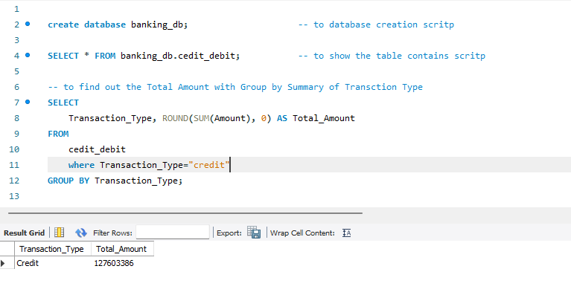
Below SQL code for :-
For creating database schema.
To calculate Total Credit & Debit Amount insights
Q1. To calculate “Total Credit Amount”

Slide 11
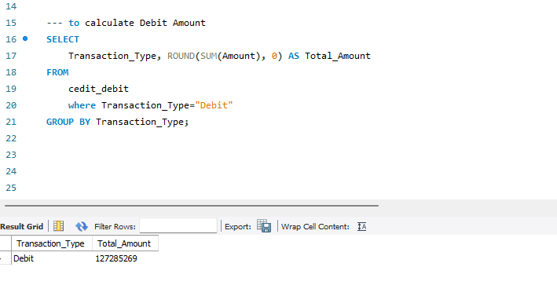
Below SQL code for :-
For creating database schema.
To calculate Total Credit & Debit Amount insights
Q2. To calculate “Total Debit Amount”

Slide 12
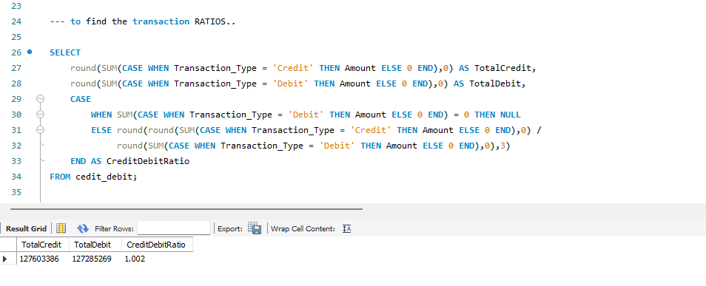
Bank Analytics & Dashboard Analytics for Stake-Holders
Below SQL code for :
To calculate Account Activity Transaction Ratio between Credit & Debit Amount insights.
Q.3 Credit & Debit Amount Ratio
Summary | Transaction Ratio
Total Credit | 127603386
Total Debit | 127285269
Total Bailance Transaction | 1.00%

Slide 13
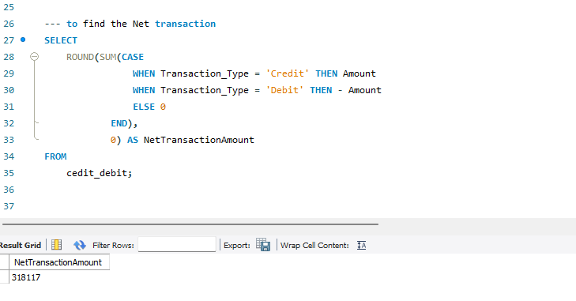
Below SQL code for :
To calculate Net Transaction between Credit & Debit Amount insights
Q.4 Net Transaction Amount=Total Credit – Total Debit
Summary | Net Transaction
Total Credit | 127603386
Total Debit | 127285269
Total Bailance Transaction | 318117

Slide 14
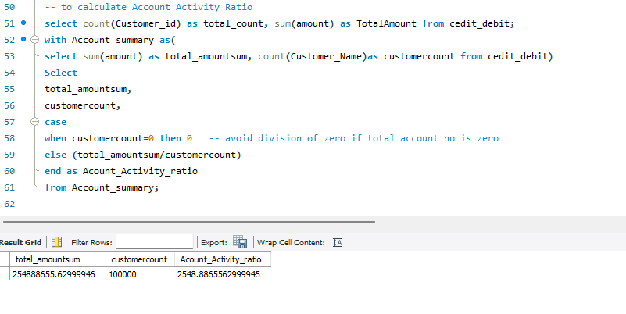
Below SQL code for :
To calculate Account Activity Ration
Q.5 Account Activity Ratio=Total Account no/Total Account Balance
Summary | Net Transaction
Total Customer count | '254888655.62999946'
Total Amount sum | '100000'
Total Account Activity Ratio | '2548.8865562999945'

Slide 15
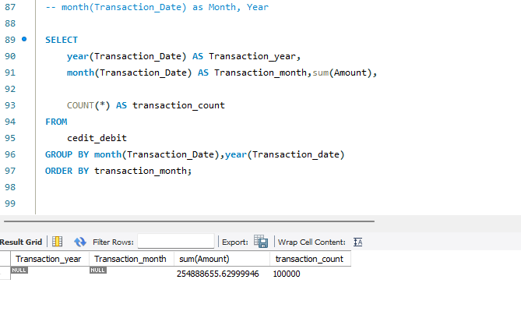
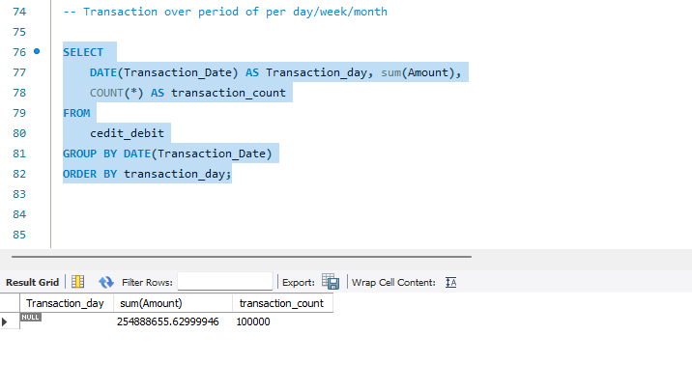
Below SQL code for :
Q.6 To calculate Total Transaction Amount by Day/Week/Month/year

Slide 16
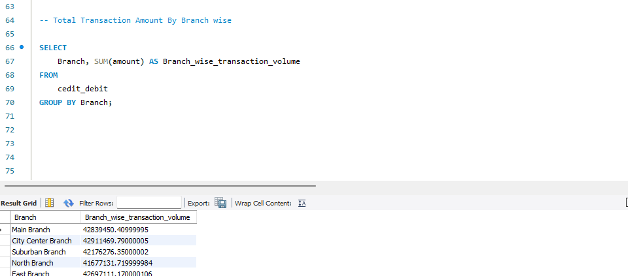
Below SQL code for :
Q.7 To calculate Total Transaction Amount by Branch wise
Summary | Net Transaction
Total Customer count | '254888655.62999946'
Total Amount sum | '100000'
Total Account Activity Ratio | '2548.8865562999945'

Slide 17
Bank Analytics & Dashboard Analytics for Stake-Holders
Loan Dashboard KPI Description
Total Loan Amount Funded: Measures the total value of loans disbursed.
Total Loans: Tracks the number of loans issued.
Total Collection: Reflects repayment performance, including principal and interest.
Total Interest: Captures revenue from loan interest.
Branch-Wise Performance: Analyzes revenue (interest, fees, total) by branch.
State-Wise Loan: Shows geographic distribution of loans.
Religion-Wise Loan: Monitors loan distribution across religious demographics.
Product Group-Wise Loan: Categorizes loans by product types (e.g., personal, auto).
Disbursement Trend: Tracks changes in loan disbursements over time.
Grade-Wise Loan: Assesses portfolio risk by borrower credit grades.
Default Loan Count: Counts loans in default.
Delinquent Client Count: Tracks borrowers with missed payments.
Delinquent Loan Rate: Percentage of loans overdue in the portfolio.
Default Loan Rate: Proportion of defaulted loans to the total portfolio.
Loan Status-Wise Loan: Breaks down loans by status (active, delinquent, closed).
Age Group-Wise Loan: Categorizes loans by borrowers’ age groups.
Loan Maturity: Tracks the timeline until full repayment
No Verified Loans: Identifies loans without proper verification.

Slide 18
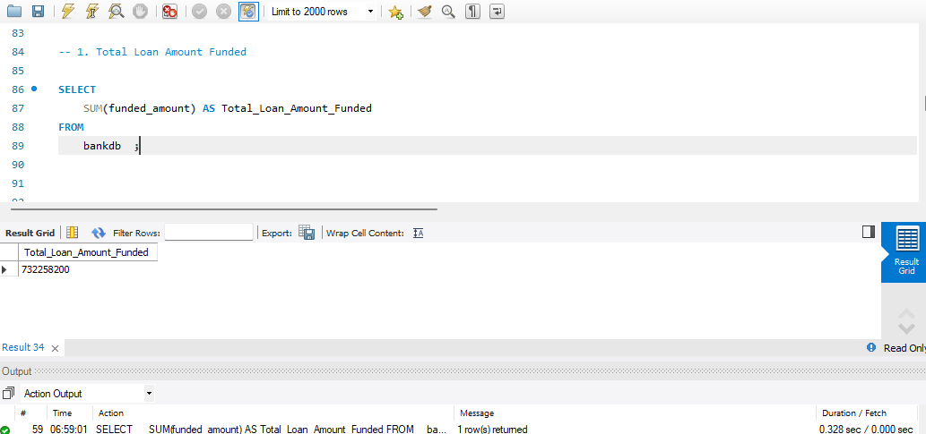
Below SQL code for Banking Analysis:
Q.1 Total Loan Amount Funded:

Slide 19
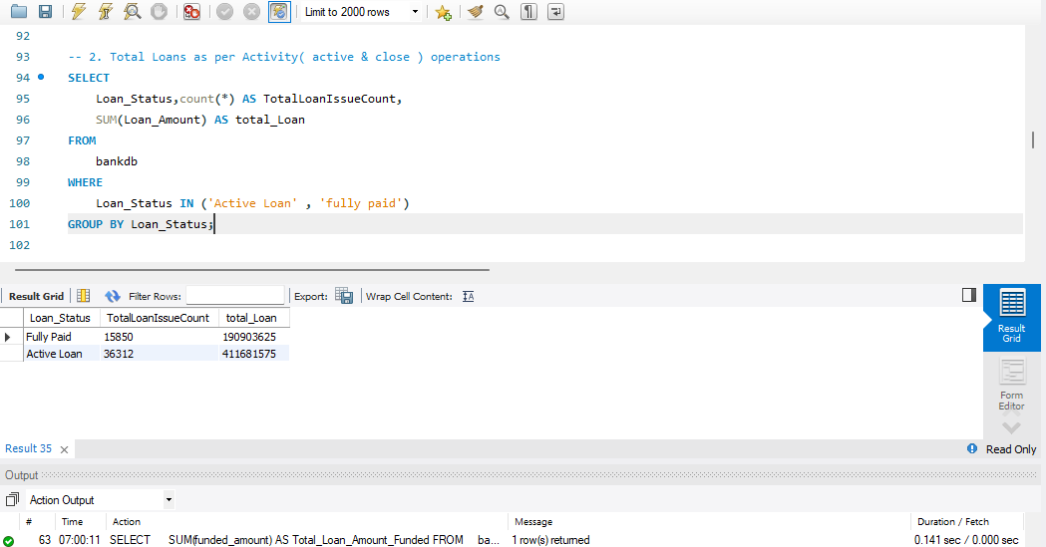
Q.2 Total Loans:

Slide 20
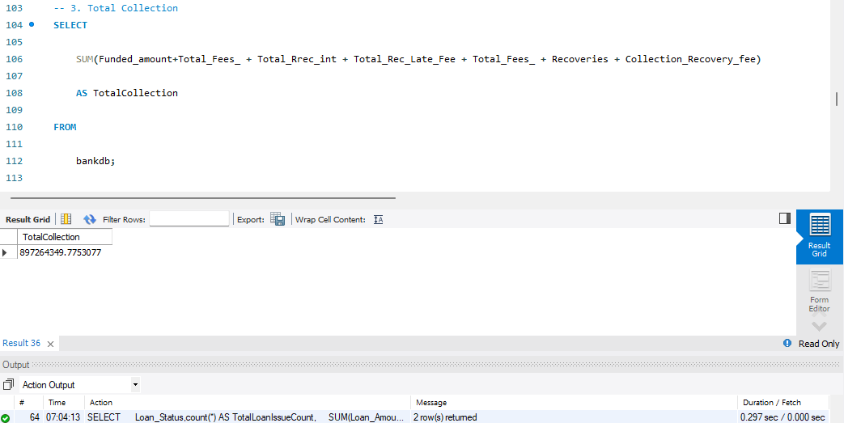
Q.3Total Collection:

Slide 21
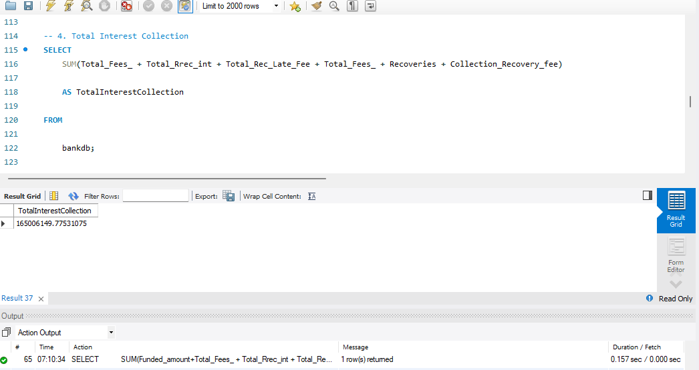
Q.4 Total Interest :

Slide 22
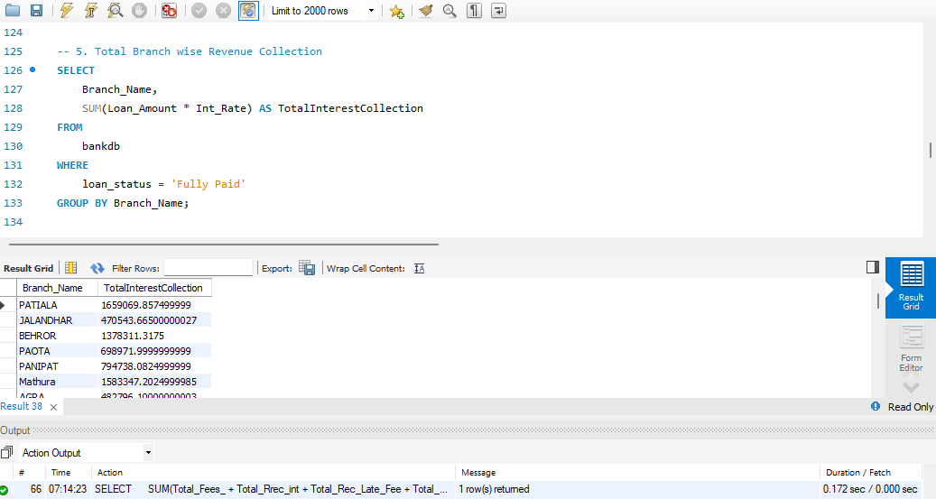
Q.5 Branch wise performance:

Slide 23
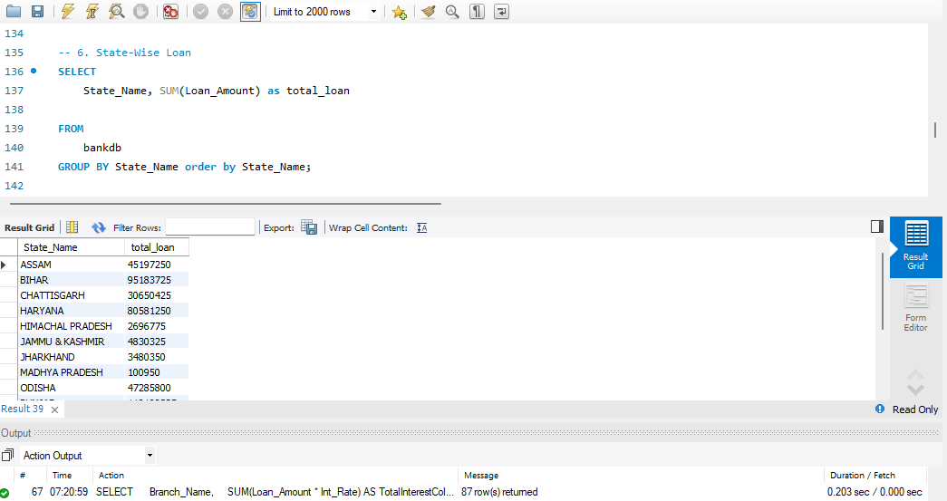
Q.7 State Wise Loan:

Slide 24
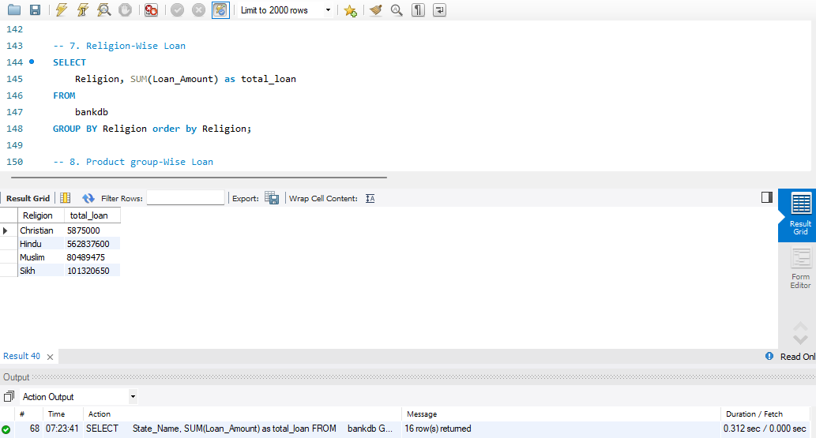
Q.8 Religion Wise Loan:

Slide 25
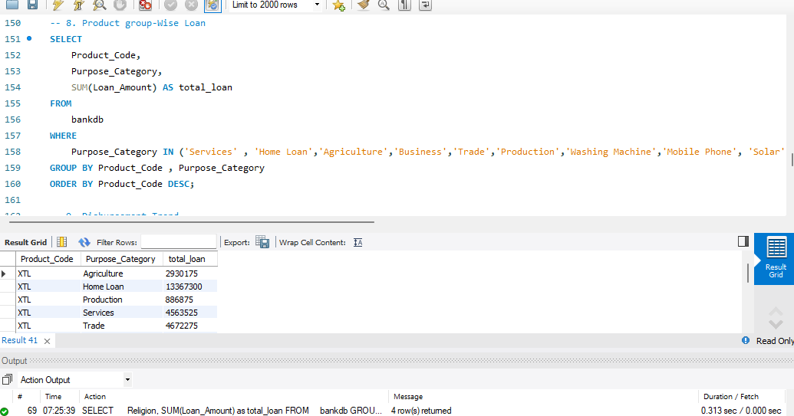
Q.9 Product group Wise Loan:

Slide 26
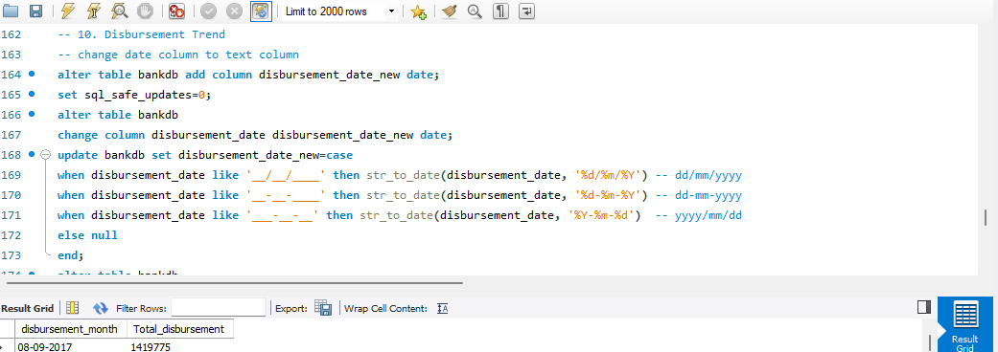
Q.10 Disbursement Trend Wise Loan:

Slide 27
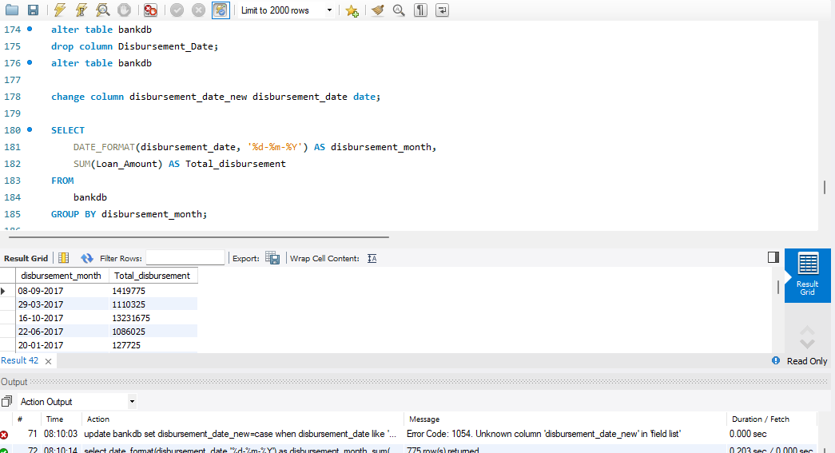

Slide 28
THANKS
Team size and Name:
1. GANESH PRASAD SHAH
2. Aneesha K.P
3. Md. Sujal

